Slide 1
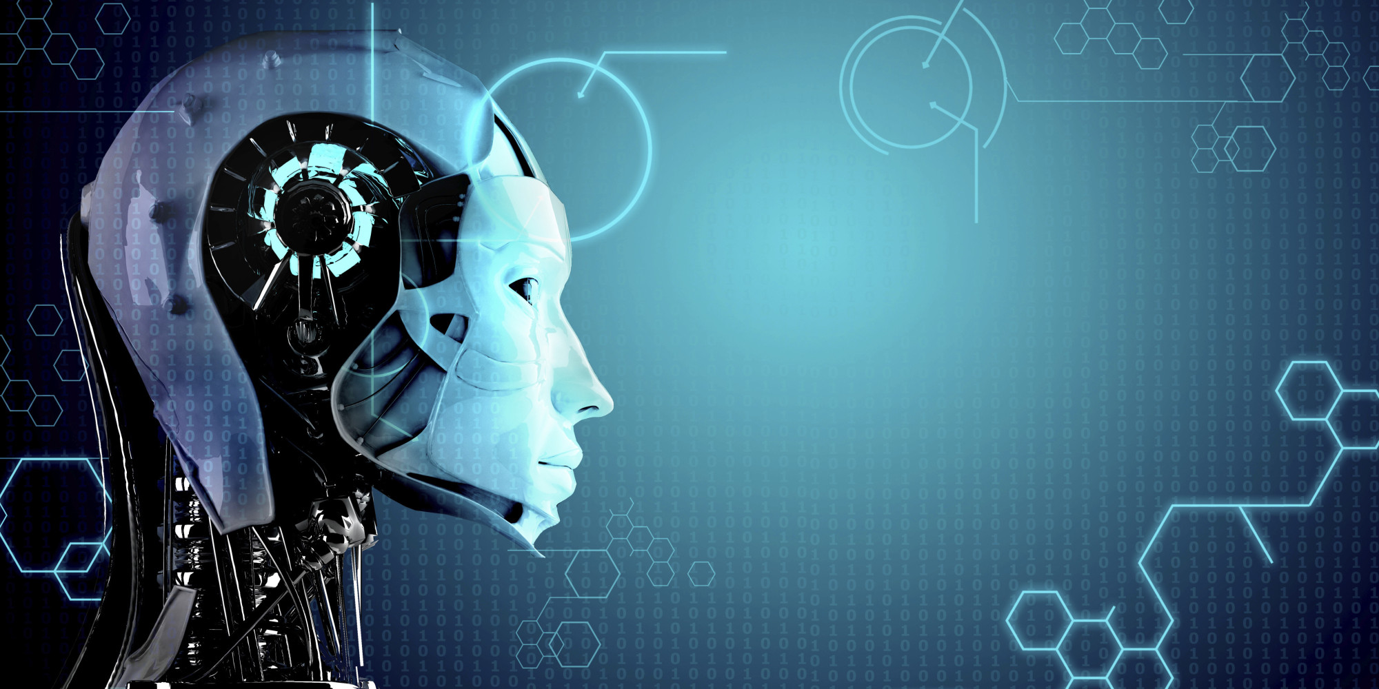
Current Trends in AI
Presented by
Akshay Dongare
Kevin Menezes

Slide 2
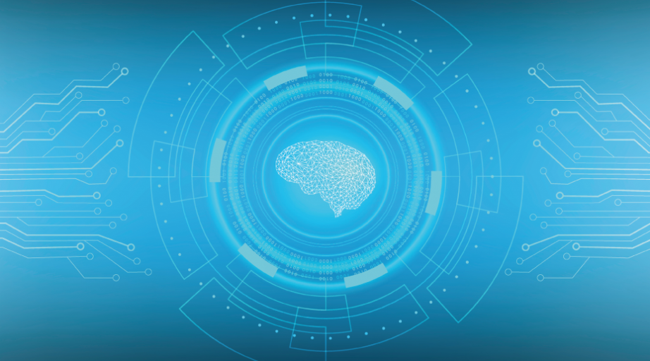
What Is Artificial Intelligence?
According to the father of Artificial Intelligence John McCarthy, it is “The science and engineering of making intelligent machines, especially intelligent computer programs”.

Slide 3
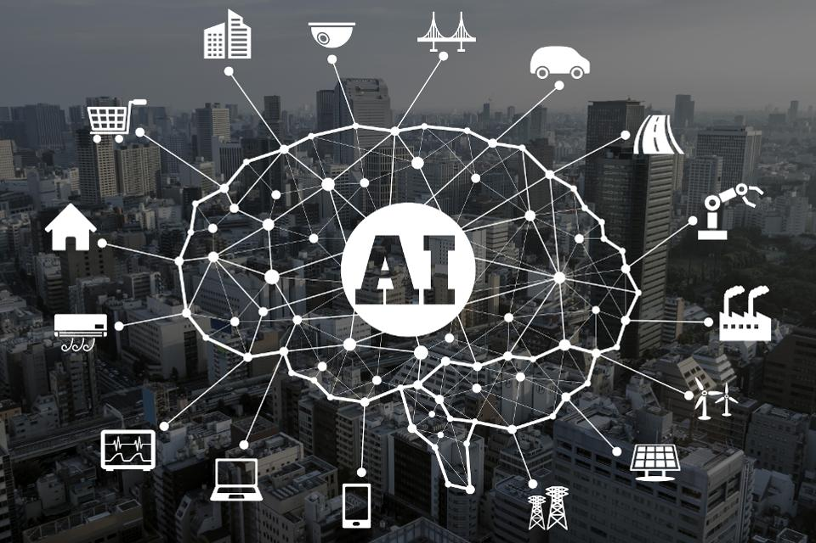
Current Trends

Slide 4

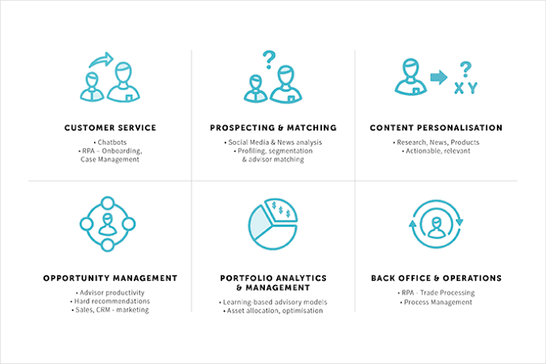
AI In Business
Chabots
Case Studies
Social Media News Analysis
Profiling
Research, News
Products relevant
Advisor Productivity
Hard Recommendations
Sales Marketing
Trade Processing
Process Management
Learning based advisory models
Optimization

Slide 5
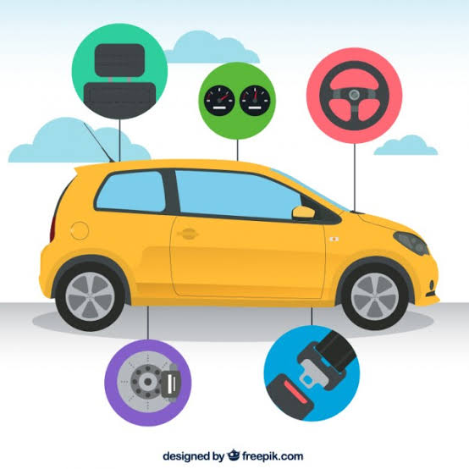
AI In Automobile
To develop self driving cars
To search safe and efficient routes
To increase better driving experience
Automatic collision notification and
notification about functioning of vehicle

Slide 6
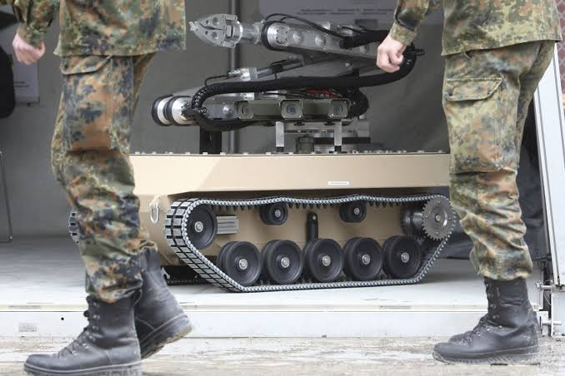

AI For Security
AI is being used to construct
Automatic weapons
To develop drones which will
Function as spy
AI techniques are used to develop
security system like face reorganization system and system
to figure out anonyms actions.
Financial , energy , cyber security

Slide 7

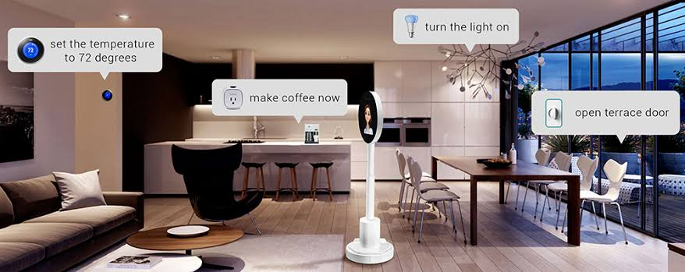
AI To Make Home Smart
Many companies are developing
smart gadgets like freeze , Air Conditioner
Washing machines which uses
fuzzy logic system for their operation.
With IoT AI is being used to make
homes smart
Amazon Alexa is one of such gadgets which
can accept commands and play music

Slide 8
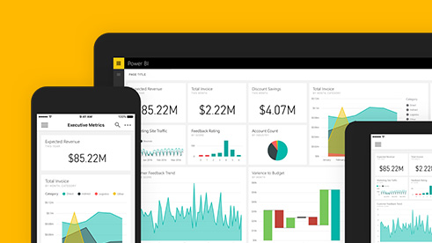
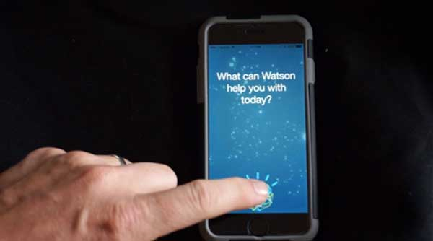
AI For Personal Use
Personal Assistant .
Increasing numbers of application
Providing services like appointment
Scheduling , health advising , helping
work and shopping, helping in
Education and entertainment
e.g. Apple Siri , Microsoft Cortana ,
Facebook M , Amazon Alexa ,
Luka chatbot , News360
Microsoft Translator .

Slide 9
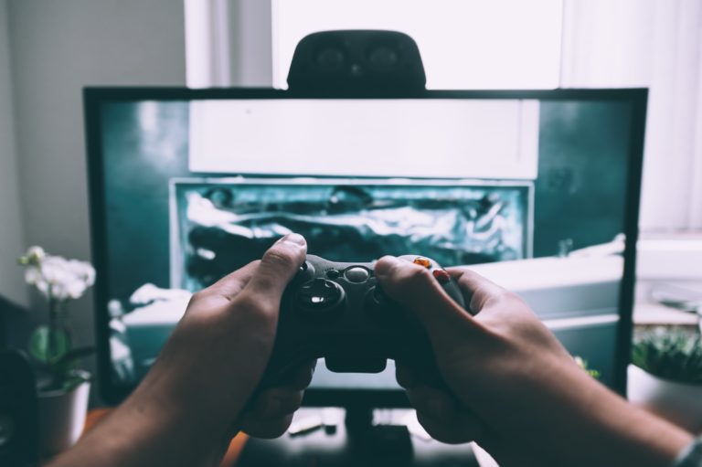
AI In Gaming
AI for better gaming experience
For virtualization of human emotions
and realism using machine learning.
Analyze players experience
and feedback
More powerful consoles and graphics
Cards are providing assistance to AI
To provide more realistic experience

Slide 10
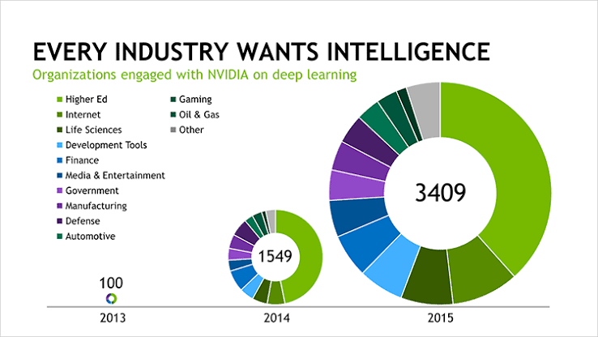
AI In Industry

Slide 11
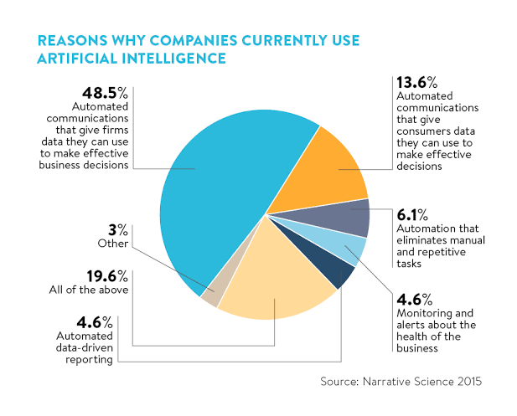

Slide 12
